Slide 1
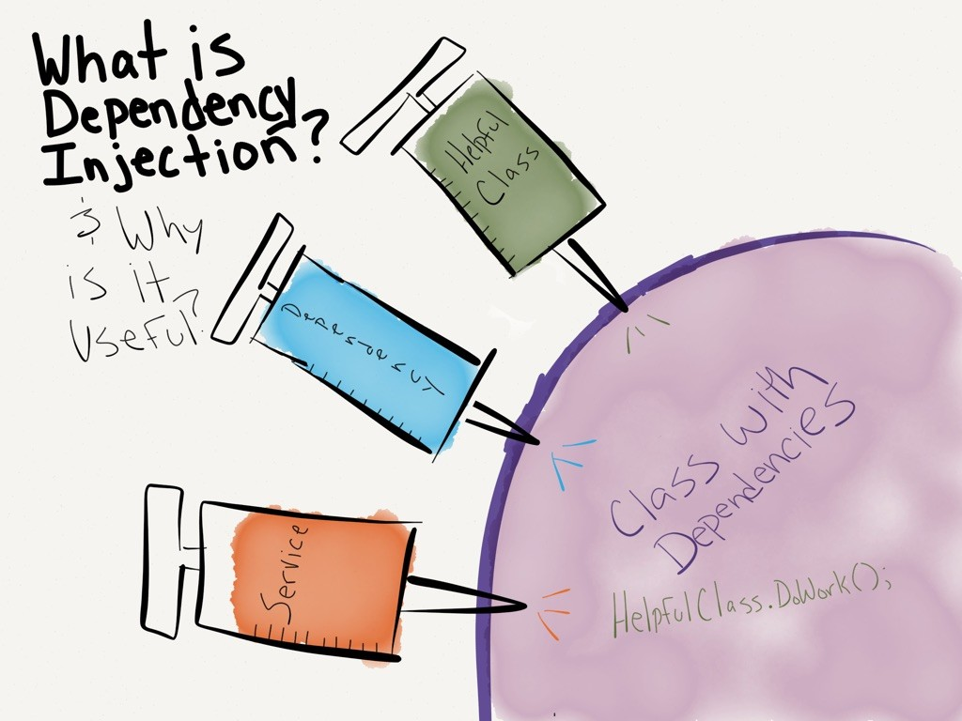
C♯ Dependency Injection Testing Entity Framework
Rasmus Lystrøm
Associate Professor
ITU

Slide 2

Agenda
Repository pattern
Testing database code
Dependency Injection
Testing Entity Framework
This Photo by Unknown Author is licensed under CC BY-NC-ND

Slide 3
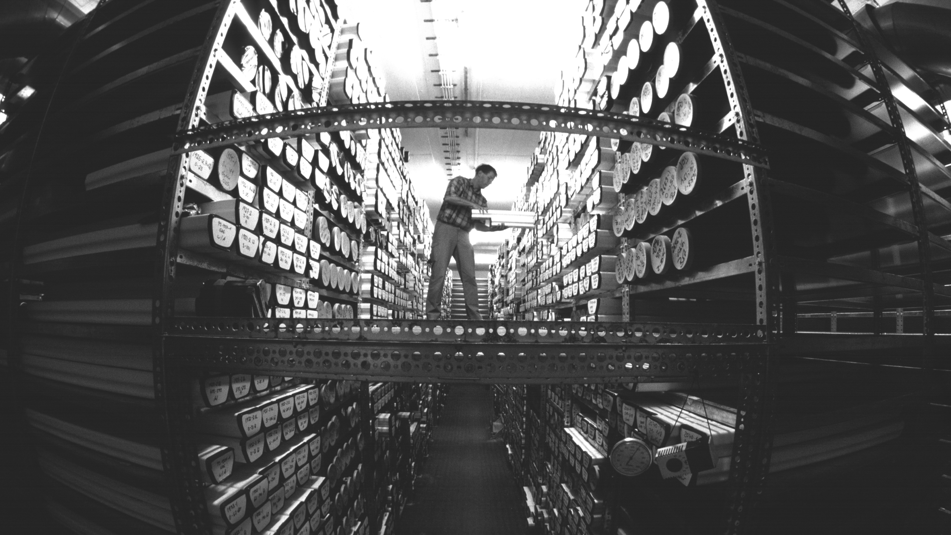
The Repository Pattern
This Photo by Unknown Author is licensed under CC BY-SA

Slide 4
The Repository Pattern
Enable CRUD on domain objects (entities)
Usually: one repository per entity
Debatable: has a Save() method

Slide 5
Generic Repository
public interface Repository<T, K>
{
T Create(T entity);
IReadOnlyCollection<T> Read();
T Read(K id);
void Update(T entity);
void Delete(K id);
}

Slide 6
The Repository Pattern
… but wait … Entity Framework already does not for me!?

Slide 7
Recommended Repository: Per entity e.g., Character
public interface ICharacterRepository : IDisposable
{
int Create(CharacterDetailsDTO character);
CharacterDetailsDTO Read(int characterId);
IReadOnlyCollection<CharacterDTO> Read();
void Update(CharacterDetailsDTO character);
void Delete(int characterId);
}
…or something similar…

Slide 8
Testing …
Testing live databases is hard
Testing live full systems is hard
By transitivity: Testing … is hard…

Slide 9
http://dwiardiirawan.com/index.php/2016/05/18/what-is-dependency-injection-and-what-are-the-advantage/

Slide 10
Dependency Injection
Software design pattern which implements Inversion of Control (IoC)

Slide 11
Dependency Injection (DI)
Constructor Injection
Property (Setter) Injection
Interface Injection

Slide 12

Dependency Injection
Structured readable code
Testable code
Dependency Inversion Principle
Separation of Concerns
Rock SOLID!!!
AWESOME!!
Pun intended

Slide 13
Programming to interface, not implementation…
public interface IFooService
{
bool Bar(Foo foo);
}
public class FooService : IFooService
{
bool Bar(Foo foo)
{
// Implementation
}
}
public interface IFooMapper
{
Foo Map(Qux qux);
}

Slide 14

Using IFooService ?
public class Baz
{
public bool Grault(Qux qux)
{
IFooMapper mapper = new FooMapper();
var foo = mapper.Map(qux);
IFooService service = new FooService();
return service.Bar(foo);
}
}

Slide 15
Constructor Injection (preferred)
public class Baz
{
private readonly IFooMapper _mapper;
private readonly IFooService _service;
public Baz(IFooMapper mapper, IFooService service)
{
_mapper = mapper;
_service = service;
}
public bool Grault(Qux qux)
{
var foo = _mapper.Map(qux);
return _service.Bar(foo);
}
}
Private readonly fields
Initialize from constructor

Slide 16
Property Injection
Public setter
public class Baz
{
public IFooService Service { private get; set; }
public bool Grault(Qux qux)
{
...
return Service?.Update(foo);
}
}
Is this King?

Slide 17
Interface Injection
public interface IServiceSetter<T>
{
void SetService(T service);
}
public interface IServiceSetter<T>
{
T Service { set; }
}

Slide 18
Interface Injection II
Interface
public class Baz : IServiceSetter<IFooService>
{
private IFooService _service;
public void SetService(IFooService service)
{
_service = service;
}
public bool Grault(Qux qux)
{
// Implementation
}
}
Implement interface

Slide 19
Interface Injection III
Interface
public class Baz : IServiceSetter<IFooService>
{
public IFooService Service { private get; set; }
public bool Grault(Qux qux)
{
// Implementation
}
}
Implement interface

Slide 20
Best practices
Use
Use Adapter to enable interface if needed
Use
Use constructor injection
Program
Program to interface
Use
Use an IoC container
More on this in a couple of weeks...

Slide 21
Testing Entity Framework

Slide 22
SQLite in-memory database
dotnet add package Microsoft.EntityFrameworkCore.Sqlite
using var connection = new SqliteConnection("Filename=:memory:");
connection.Open();
var builder = new DbContextOptionsBuilder<MyContext>().UseSqlite(connection);
using var context = new MyContext(builder.Options);

Slide 23
Demo
Black box testing with SQLite in-memory

Slide 24
Best practices
Wrap in logical units/service classes/repositories
Don’t test built-in code…
Program to interface
Repositories should not depend on other repositories

Slide 25
Thank you

